Slide 1
SRI RAMAKRISHNA ENGINEERING COLLEGE
[Educational Service : SNR Sons Charitable Trust]
[Autonomous Institution, Reaccredited by NAAC with ‘A+’ Grade]
[Approved by AICTE and Permanently Affiliated to Anna University, Chennai]
[ISO 9001-2015 Certified and all eligible programmes Accredited by NBA]
VATTAMALAIPALAYAM, N.G.G.O. COLONY POST, COIMBATORE – 641 022.
Department of Electronics and Communication Engineering
20EC214 & DIGITAL CMOS VLSI CIRCUITS
Course Instructor:
Mr.R.Chandru,
Assistant Professor(Sl.G)/ECE
No. of Credits : 3

Slide 2
20EC214 - DIGITAL CMOS VLSI CIRCUITS COURSE OUTCOMES
On successful completion of the course, students will be able to,
COURSE OUTCOMES
CO₁ | Interpret the characteristics and manufacturing process technologyof MOS transistor.
CO₂ | Analyze the various logic styles of CMOS combinational andsequential circuits
CO₃ | Design the various digital arithmetic logic circuits.
CO₄ | Illustrate the performance of the digital circuits by examining the timing issues.
CO₅ | Make use of MOS concepts in construction of Memory Array Subsystem.

Slide 3
20EC214 - DIGITAL CMOS VLSI CIRCUITS COURSE CONTENTS
PREREQUISITES
20EC204 - Digital System Design
MOS TRANSISTOR AND PROCESSING 10
MOSFET theory - Transistor switches - Compound gates - Design equations - IV characteristics - CV characteristics - Second order effects - Energy and Power - Resistance Estimation - Capacitance Estimation - Switching Characteristics - RC Delay Models - Logical Effort for gates - CMOS Process technology - Design Rules and Layout.
CMOS LOGIC STRUCTURES 11
Combinational Circuits: CMOS Inverter - DC Characteristics - Complementary Logic Structures - Ratioed logic - Pass transistor logic - Transmission gate - Tristate Inverter - Multiplexers - Dynamic logic structures. Sequential Circuits: Static latches and Registers, Dynamic latches and Registers, Pulse Registers, Sense Amplifier Based Register, Pipelining.
DESIGN OF ARITHMETIC BUILDING BLOCKS 8
Full adder, Ripple carry adder, Carry bypass adder, Linear and Square root carry-select adder, Carry look-ahead adder - Multipliers - Barrel and logarithmic shifter.
TIMING ISSUES 8
Timing Basics, Sources of Skew and Jitter, Clock-Distribution Techniques, Latch-Based locking, Self-Timed Circuit Design, Synchronizers and Arbiters, Clock Synthesis and Synchronization Using a Phase-Locked Loop.
MEMORY ARRAY SUBSYSTEM 8
SRAM: SRAM Cells, Row Circuitry, Column Circuitry. Multiported SRAM and Register files DRAM: Subarray Architectures, Column Circuitry, Embedded DRAM. Read-Only Memory: Programmable ROMs, NAND ROMs, Flash.

Slide 4
20EC214 - DIGITAL CMOS VLSI CIRCUITS COURSE CONTENTS
TEXT BOOKS
Neil H.E. Weste and David Harris, "CMOS VLSI Design A Circuits and Systems Perspective", 4th Edition, Pearson Education, Reprint 2010.
Jan M. Rabaey, Anantha Chandrakasan and B Nikolic, "Digital Integrated Circuits: A Design Perspective", 2nd Edition, Pearson Education India, 2016.
REFERENCES
Douglas. A. Pucknell, Kamran Eshraghian, "Basic VLSI Design", 3rd Edition, Prentice Hall India, 2010.
John P.Uyemura, "Introduction to VLSI Circuits and Systems", John Wiley & Sons, 2012.
WEB REFERENCES
https://nptel.ac.in/courses/108/107/108107129/
https://nptel.ac.in/courses/117/106/117106093/

Slide 5
MODULE 2 MOS TRANSISTOR AND PROCESSING TECHNOLOGY
□ CMOS Inverter – DC Characteristics
□ CMOS Inverter – Transient Characteristics
□ Complementary Logic Structures
□ Ratioed Logic
□ Pass Transistor Logic
□ Transmission Gate
□ Tristate Inverter
□ Multiplexers
□ Dynamic Logic Structures
□ Sequential Circuits:
Static Latches and Registers
Dynamic Latches and Registers
Pulse Registers
Sense Amplifier Based Register
Pipelining

Slide 6
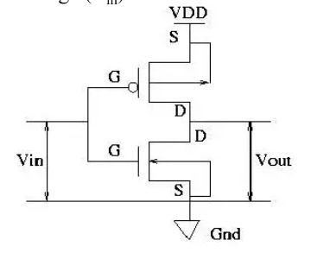
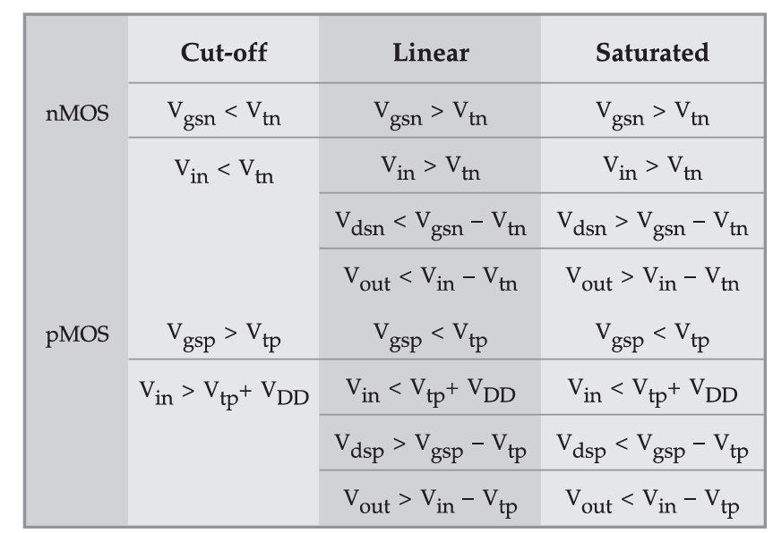
MODULE 2 CMOS Inverter – DC Characteristics
DC Transfer Characteristics of CMOS Inverter

Slide 7
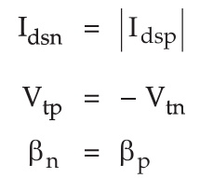
MODULE 2 CMOS Inverter – DC Characteristics
DC Transfer Characteristics of CMOS Inverter
What Do We Mean by DC Characteristics?
The DC transfer characteristic of a CMOS inverter represents the relationship between output voltage (Vout) and input voltage (Vin) when the input changes slowly.
We assume:
No capacitive effects (steady state)
Internal capacitances fully charged/discharged
Only DC current equations apply
This means the current flowing through NMOS must equal the current flowing through PMOS because they are connected in series between VDD and ground.

Slide 8
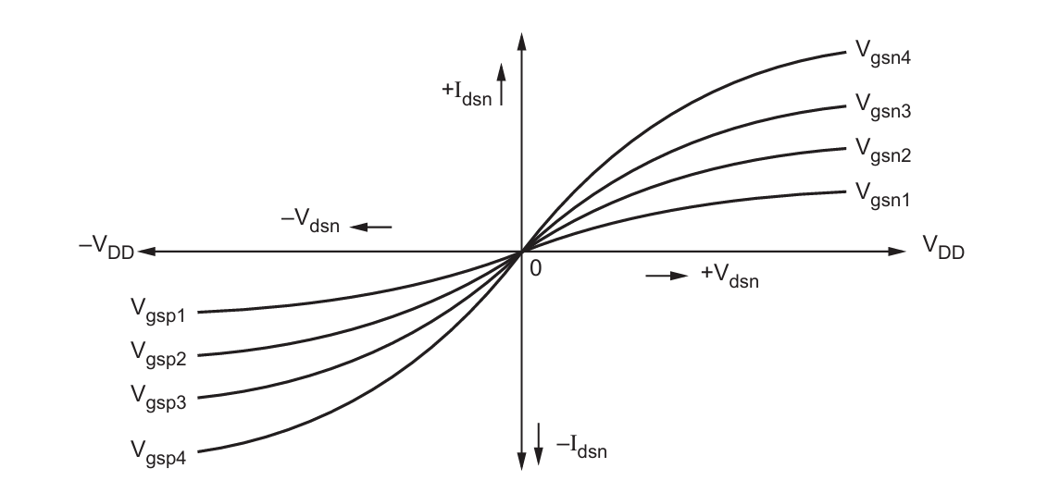
MODULE 2 CMOS Inverter – DC Characteristics
DC Transfer Characteristics of CMOS Inverter

Slide 9
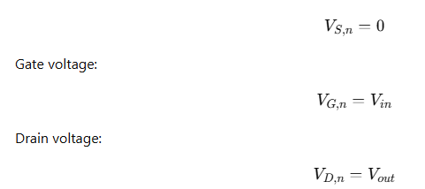
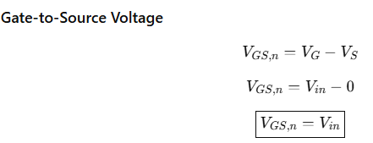
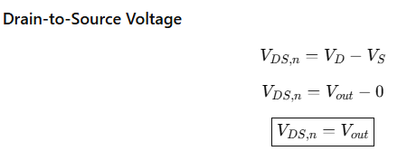
MODULE 2 CMOS Inverter – DC Characteristics
NMOS Voltage Expressions:

Slide 10
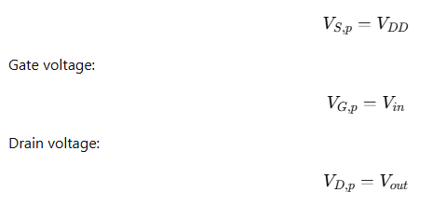
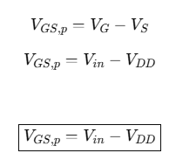
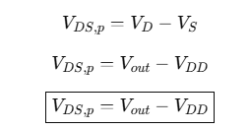
MODULE 2 CMOS Inverter – DC Characteristics
PMOS Voltage Expressions:

Slide 11
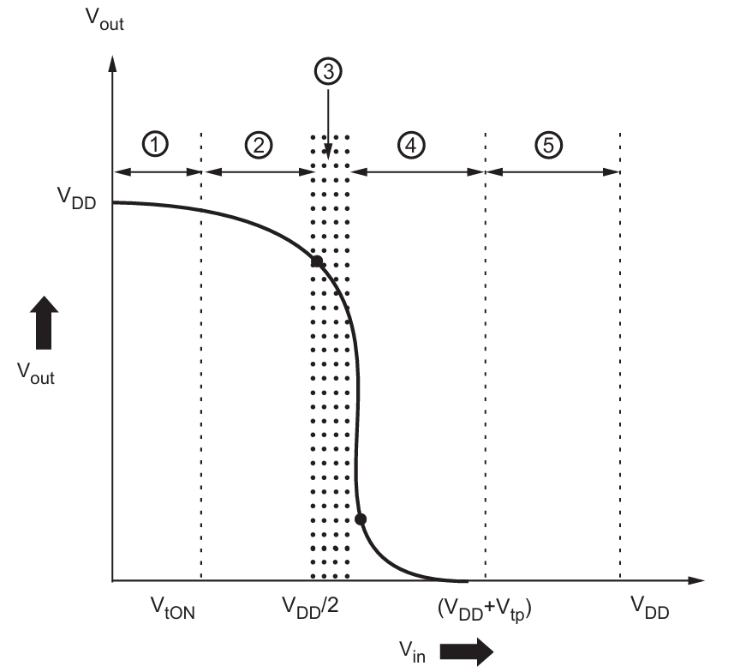
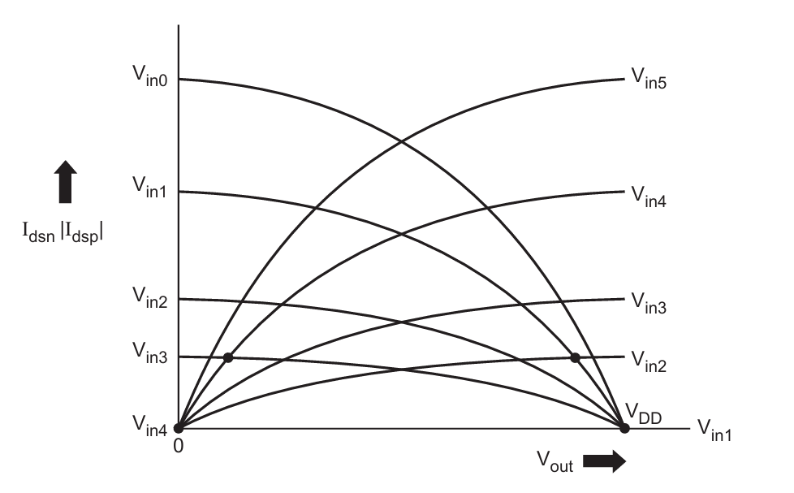
MODULE 2 CMOS Inverter – DC Characteristics

Slide 12

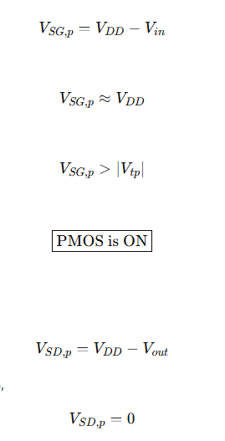
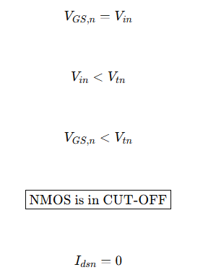




MODULE 2 CMOS Inverter – DC Characteristics
PMOS
NMOS
Because in steady state:
Output Voltage

Slide 13

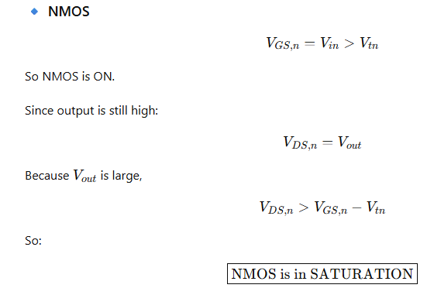
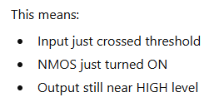
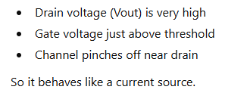
MODULE 2 CMOS Inverter – DC Characteristics

Slide 14
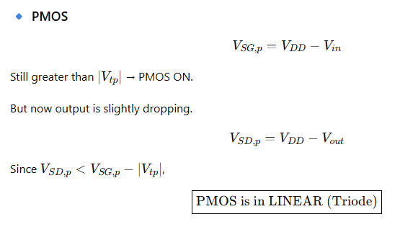
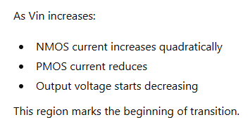
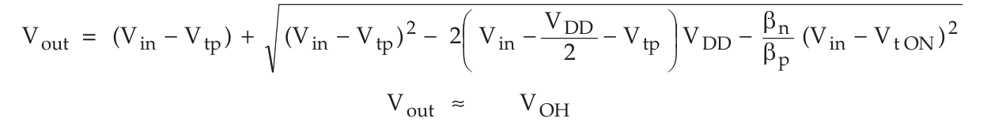
MODULE 2 CMOS Inverter – DC Characteristics

Slide 15

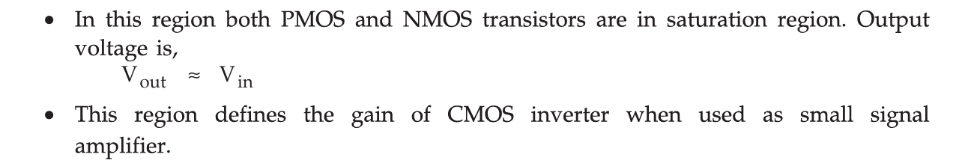
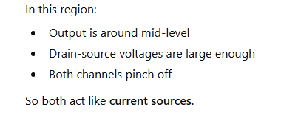
MODULE 2 CMOS Inverter – DC Characteristics

Slide 16


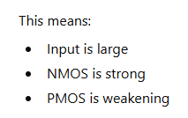
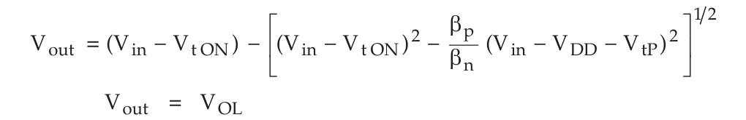
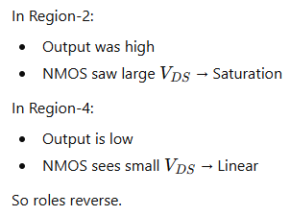
MODULE 2 CMOS Inverter – DC Characteristics

Slide 17
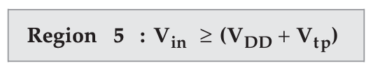
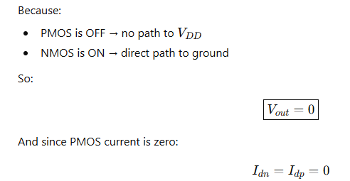
MODULE 2 CMOS Inverter – DC Characteristics

Slide 18
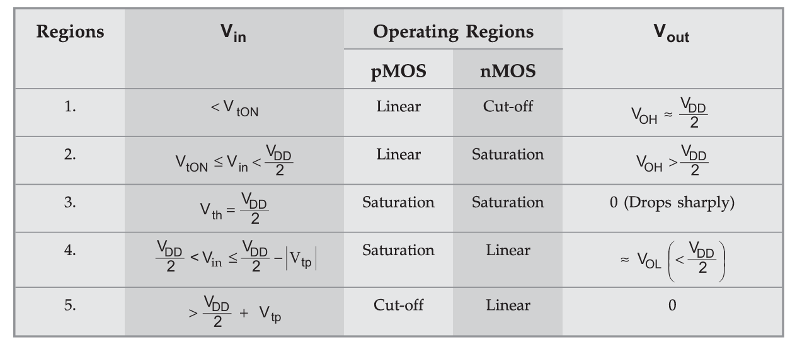
MODULE 2 CMOS Inverter – DC Characteristics
CMOS Inverter – DC Regions

Slide 19
MODULE 2
Advanced Logic Families: Ratioed, Pseudo-nMOS, and Pass-Transistor Logic
In a standard CMOS (Complementary) logic gate, the pull-up network (PUN, made of PMOS) and the pull-down network (PDN, made of NMOS) are designed to be mutually exclusive. For any input combination, either the path to VDD is on, or the path to GND is on, but never both at the same time (except during switching).
This is called ratioless logic because the output voltage doesn't depend on the relative sizes (ratios) of the transistors; it just gets pulled firmly to VDD or GND.
In ratioed logic, we simplify the gate. Instead of a complex, complementary PUN, we replace it with a simple, always-on "load" device. This load could be a resistor or, more commonly in VLSI, a single transistor.
This creates a problem: When the PDN is ON, it creates a direct path from VDD to GND through the load device and the PDN.

Slide 20
MODULE 2
Advanced Logic Families: Ratioed, Pseudo-nMOS, and Pass-Transistor Logic
In a standard CMOS inverter:
When input is HIGH → output is exactly 0V.
When input is LOW → output is exactly VDD.
If I make the NMOS transistor 100 times wider than the PMOS, does the output low change from 0V?
If I make both transistors extremely small, does the output high change from VDD?
That means the output voltage levels in CMOS do not depend on transistor sizing.
That is why CMOS is called: RATIOLESS LOGIC

Slide 21
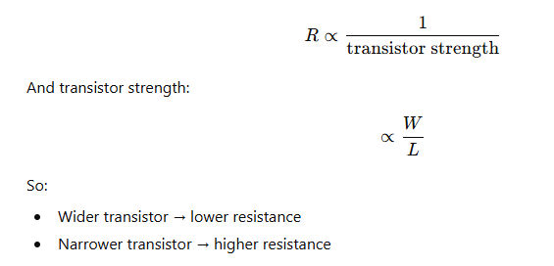
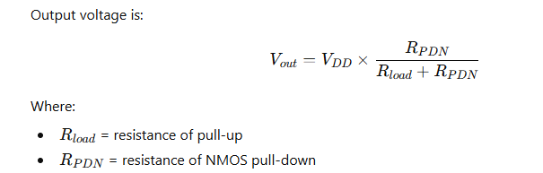
MODULE 2
Advanced Logic Families: Ratioed, Pseudo-nMOS, and Pass-Transistor Logic
In a Ratioed Logic Inverter:
• When input is LOW → output is pulled up to VDD (strong 1). • When input is HIGH → output is NOT exactly 0V.
What Happens When Input = HIGH?
Pull-up load (resistor or weak PMOS) → ALSO ON
Pull-down NMOS → ON

Slide 22

MODULE 2
Advanced Logic Families: Ratioed, Pseudo-nMOS, and Pass-Transistor Logic
MOSFET Is NOT an Ideal Switch
A MOSFET when ON behaves like:
👉 A voltage-controlled resistor.
Its resistance is not fixed — it depends on:
Transistor size (W/L)
Mobility (μ)
Gate voltage
Process parameters
Where Does “Strength” Come From?
Transistor strength is represented by:
Where:
μ = carrier mobility
Cox​ = oxide capacitance
W = transistor width
L = transistor length
So:
✔ Larger W → larger β → stronger transistor ✔ Smaller L → larger β → stronger transistor

Slide 23
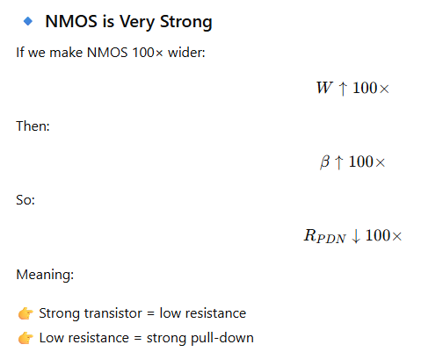
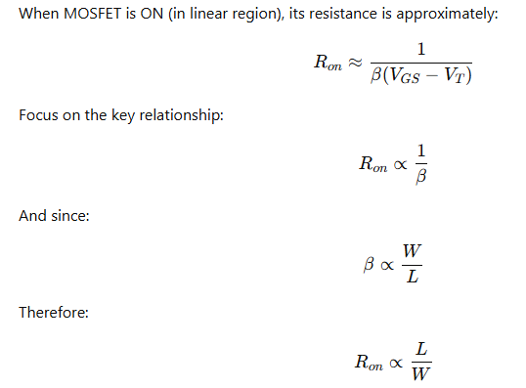
MODULE 2
Advanced Logic Families: Ratioed, Pseudo-nMOS, and Pass-Transistor Logic
ON Resistance of MOSFET

Slide 24
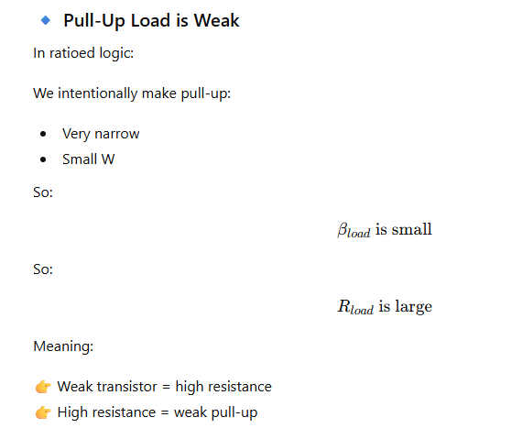
MODULE 2
Advanced Logic Families: Ratioed, Pseudo-nMOS, and Pass-Transistor Logic

Slide 25
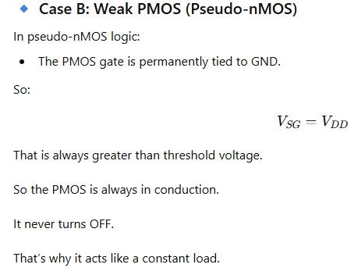
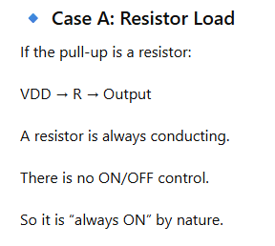
MODULE 2
Advanced Logic Families: Ratioed, Pseudo-nMOS, and Pass-Transistor Logic
In Ratioed Logic, the Pull-Up Is Designed to Be Always ON
Unlike CMOS, where:
PMOS turns OFF when input = 1
In ratioed logic, the pull-up device is not controlled by the input.
It is intentionally biased so that:
👉 It is always conducting.
Two Common Types of Pull-Up Loads

Slide 26
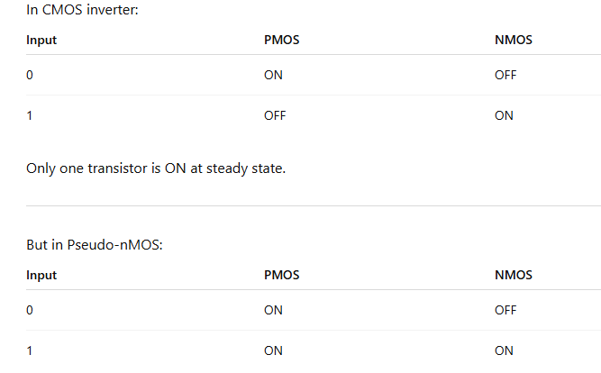
MODULE 2
Advanced Logic Families: Ratioed, Pseudo-nMOS, and Pass-Transistor Logic

Slide 27





MODULE 2
Advanced Logic Families: Ratioed, Pseudo-nMOS, and Pass-Transistor Logic
Case 1
NMOS 100× Wider Than Pull-Up
That means:
NMOS is very strong
RPDN​ is very small
Pull-up load is weak
Rload​ is large
✔ Output LOW moves closer to 0V.
Case 2
NMOS Weaker Than Pull-Up
Now:
NMOS is weak → large resistance
Pull-up is strong → small resistance
✔ Output LOW increases toward VDD.

Slide 28
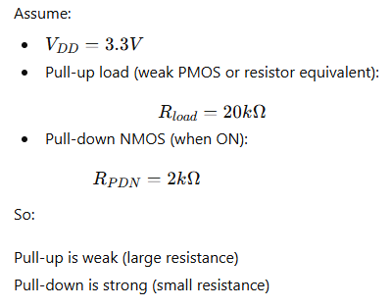
MODULE 2
Advanced Logic Families: Ratioed, Pseudo-nMOS, and Pass-Transistor Logic

Slide 29
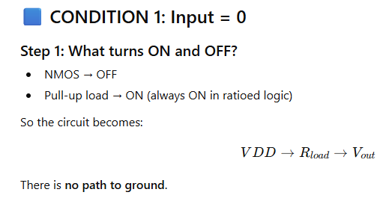
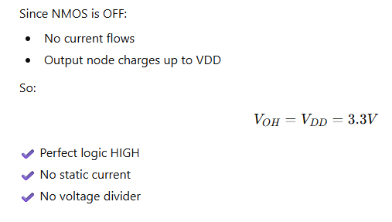
MODULE 2
Advanced Logic Families: Ratioed, Pseudo-nMOS, and Pass-Transistor Logic

Slide 30
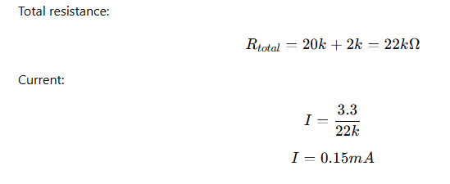
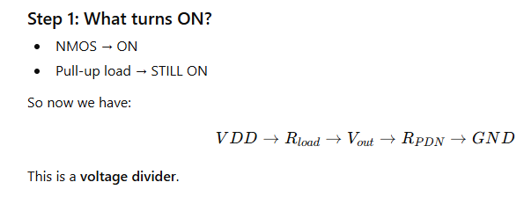
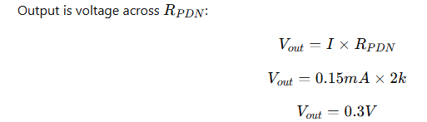
MODULE 2
Advanced Logic Families: Ratioed, Pseudo-nMOS, and Pass-Transistor Logic
CONDITION 2: Input = 1
✔ Good LOW ✔ But not exactly 0V ✔ Static current flows continuously

Slide 31
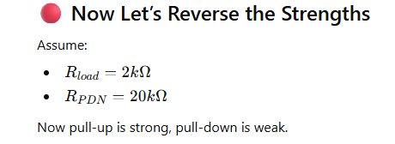
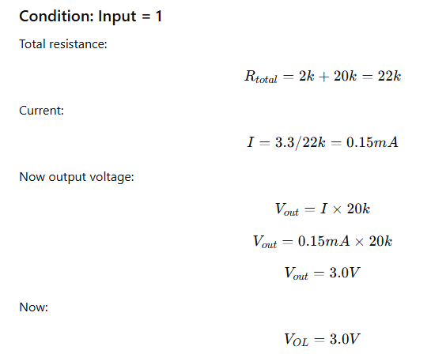
MODULE 2
Advanced Logic Families: Ratioed, Pseudo-nMOS, and Pass-Transistor Logic

Slide 32
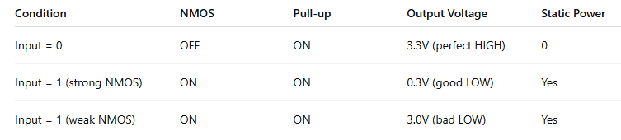
MODULE 2
Advanced Logic Families: Ratioed, Pseudo-nMOS, and Pass-Transistor Logic
Summary Table
“When input is 0, only one transistor conducts — so output is perfect.
When input is 1, two transistors conduct — so they divide voltage.
The LOW level is determined by who wins the strength battle.”

Slide 33
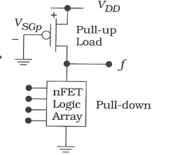
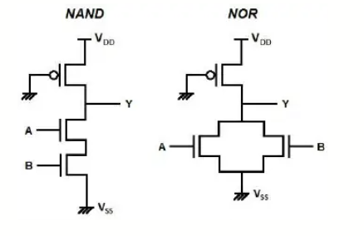
MODULE 2
Advanced Logic Families: Ratioed, Pseudo-nMOS, and Pass-Transistor Logic
Pseudo-nMOS

Slide 34
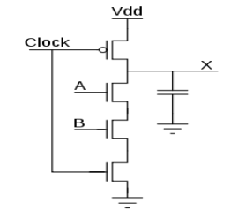
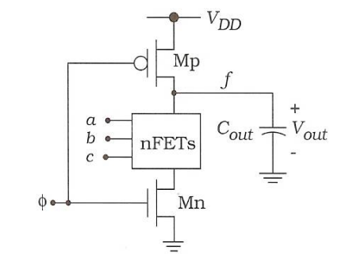
MODULE 2
Advanced Logic Families: Ratioed, Pseudo-nMOS, and Pass-Transistor Logic
Dynamic Logic

Slide 35
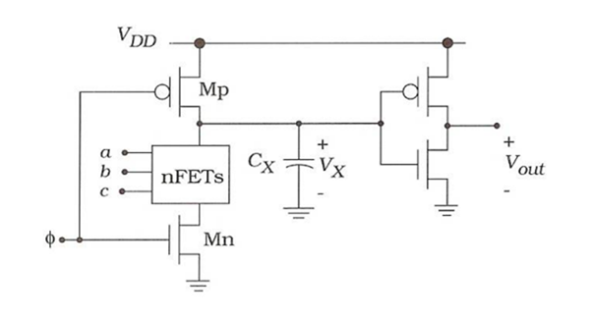
MODULE 2
Advanced Logic Families: Ratioed, Pseudo-nMOS, and Pass-Transistor Logic
Domino Logic

Slide 36
MODULE 2
Advanced Logic Families: Ratioed, Pseudo-nMOS, and Pass-Transistor Logic

Slide 37


MODULE 2
Advanced Logic Families: Ratioed, Pseudo-nMOS, and Pass-Transistor Logic

Slide 38


MODULE 2
Advanced Logic Families: Ratioed, Pseudo-nMOS, and Pass-Transistor Logic
DYNAMIC CMOS

Slide 39

MODULE 2
Advanced Logic Families: Ratioed, Pseudo-nMOS, and Pass-Transistor Logic

Slide 40


MODULE 2
Advanced Logic Families: Ratioed, Pseudo-nMOS, and Pass-Transistor Logic

Slide 41




MODULE 2
Advanced Logic Families: Ratioed, Pseudo-nMOS, and Pass-Transistor Logic
ADVANTAGES OF DYNAMIC CMOS

Slide 42



MODULE 2
Advanced Logic Families: Ratioed, Pseudo-nMOS, and Pass-Transistor Logic

Slide 43


MODULE 2
Advanced Logic Families: Ratioed, Pseudo-nMOS, and Pass-Transistor Logic
CHALLENGES OF DYNAMIC CMOS

Slide 44


MODULE 2
Advanced Logic Families: Ratioed, Pseudo-nMOS, and Pass-Transistor Logic

Slide 45
MODULE 2
Advanced Logic Families: Ratioed, Pseudo-nMOS, and Pass-Transistor Logic
Domino Logic

Slide 46


MODULE 2
Advanced Logic Families: Ratioed, Pseudo-nMOS, and Pass-Transistor Logic
Limitations of Domino Logic

Slide 47

MODULE 2
Advanced Logic Families: Ratioed, Pseudo-nMOS, and Pass-Transistor Logic
Monotonicity

Slide 48

MODULE 2
Advanced Logic Families: Ratioed, Pseudo-nMOS, and Pass-Transistor Logic

Slide 49
MODULE 2
Advanced Logic Families: Ratioed, Pseudo-nMOS, and Pass-Transistor Logic
NP Domino Logic
NP Domino logic, also called NORA (No Race) Logic, is an advanced form of dynamic CMOS logic in which N-type and P-type dynamic stages are alternated to allow safe cascading without using static inverters.
It overcomes the limitations of conventional domino logic such as:
Extra inverter delay
Only non-inverting logic possible
Increased are
Core Idea:
N-Domino stage: Uses NMOS pull-down network, precharges HIGH
P-Domino stage: Uses PMOS pull-up network, precharges LOW
Alternating arrangement eliminates need for static inverters between stages
Key Innovation:
True logic and complementary logic in same chain
No static inverters between stages (saves area and delay)
Single clock controlling entire pipeline (with proper timing)

Slide 50

MODULE 2
Advanced Logic Families: Ratioed, Pseudo-nMOS, and Pass-Transistor Logic

Slide 51


MODULE 2
Advanced Logic Families: Ratioed, Pseudo-nMOS, and Pass-Transistor Logic
P-Type Dynamic Block
N-Type Dynamic Block

Slide 52

MODULE 2
Advanced Logic Families: Ratioed, Pseudo-nMOS, and Pass-Transistor Logic
Clocking Scheme

Slide 53

MODULE 2
Advanced Logic Families: Ratioed, Pseudo-nMOS, and Pass-Transistor Logic
Working Principle

Slide 54
MODULE 2
Advanced Logic Families: Ratioed, Pseudo-nMOS, and Pass-Transistor Logic
TRANSMISSION GATE IN CMOS
Why Do We Need Transmission Gates?
Definition:
A transmission gate is a solid-state semiconductor switch that controls the transmission path of analog and digital signals using digitally controlled logic levels.
Also Known As:
Bilateral switch
CMOS analog switch
TG (Transmission Gate)
Applications Requiring Electronic Switching:
Switching and routing of digital signals
Switching and routing of analogue signals
Multiplexers and demultiplexers
Latches and flip-flops
Sample-and-hold circuits
Switched capacitor circuits
Bus drivers and isolators
Audio and video signal routing

Slide 55


MODULE 2
Advanced Logic Families: Ratioed, Pseudo-nMOS, and Pass-Transistor Logic
NMOS Switch

Slide 56


MODULE 2
Advanced Logic Families: Ratioed, Pseudo-nMOS, and Pass-Transistor Logic
The MOSFET as a Switch - PMOS

Slide 57

MODULE 2
Advanced Logic Families: Ratioed, Pseudo-nMOS, and Pass-Transistor Logic
The Problem with Single Transistor Switches

Slide 58
MODULE 2
Advanced Logic Families: Ratioed, Pseudo-nMOS, and Pass-Transistor Logic
Transmission Gate
Combine NMOS and PMOS in parallel to get the best of both.
As signal voltage changes:
Near 0V: NMOS conducts strongly, PMOS helps
Near VDD: PMOS conducts strongly, NMOS helps
Throughout range: At least one transistor conducts well

Slide 59

MODULE 2
Advanced Logic Families: Ratioed, Pseudo-nMOS, and Pass-Transistor Logic
Transmission Gate

Slide 60


MODULE 2
Advanced Logic Families: Ratioed, Pseudo-nMOS, and Pass-Transistor Logic
Transmission Gate - Operation (ON State)

Slide 61

MODULE 2
Advanced Logic Families: Ratioed, Pseudo-nMOS, and Pass-Transistor Logic
Transmission Gate - Operation (OFF State)

Slide 62

MODULE 2
Advanced Logic Families: Ratioed, Pseudo-nMOS, and Pass-Transistor Logic
Transmission Gate - Truth Table
Boolean expression for a transmission gate of:
B = A.Control

Slide 63

MODULE 2
Advanced Logic Families: Ratioed, Pseudo-nMOS, and Pass-Transistor Logic
Pass Transistor (NMOS) Structure

Slide 64
MODULE 2
Advanced Logic Families: Ratioed, Pseudo-nMOS, and Pass-Transistor Logic

Slide 65
MODULE 2
Advanced Logic Families: Ratioed, Pseudo-nMOS, and Pass-Transistor Logic

Slide 66

MODULE 1 MOS TRANSISTOR AND PROCESSING TECHNOLOGY

